Slide 1
ADAHACK 2022 PROJECT PRESENTATION
Team Members: Alfin, Archie, Anna, Stefi, Tomas

Slide 2
TABLE OF CONTENTS
Problem Introduction
About the data
Visualisations
Reflection
Visualisations of more diverse data set
Conclusion

Slide 3
PROBLEM INTRODUCTION
The aim of the project, is to investigate the gender equality situation regarding promotions by researching into the staff data of a chosen firm from a public database on Kaggle. From this we set out to make meaningful conclusions about promotion opportunities within the workplace.
.

Slide 4
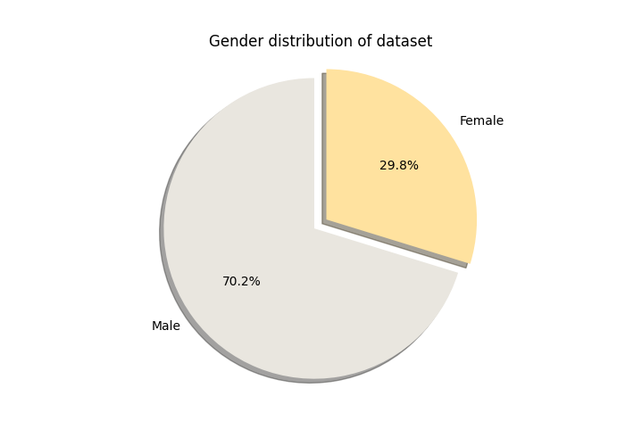
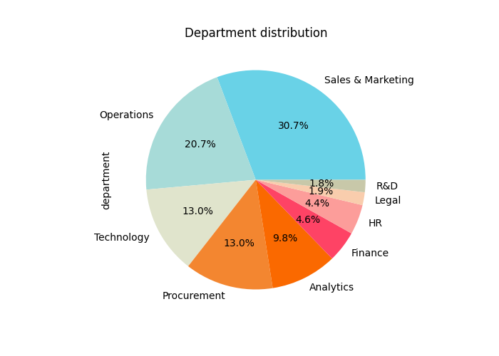
ABOUT THIS DATASET:
5.4k
records
1.6k
gender minorities

Slide 5
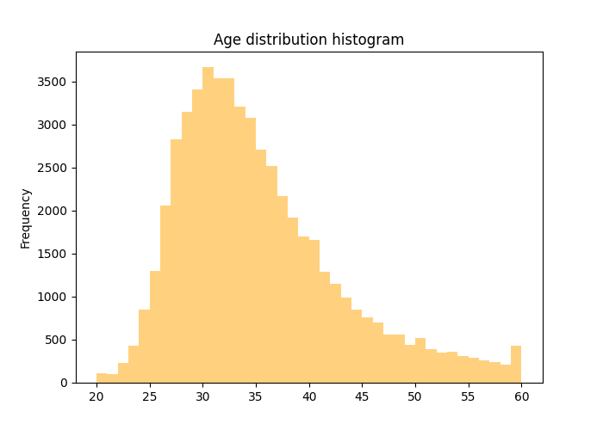
ABOUT THIS DATASET:
Representative sample of employees due to normal distribution
age

Slide 6
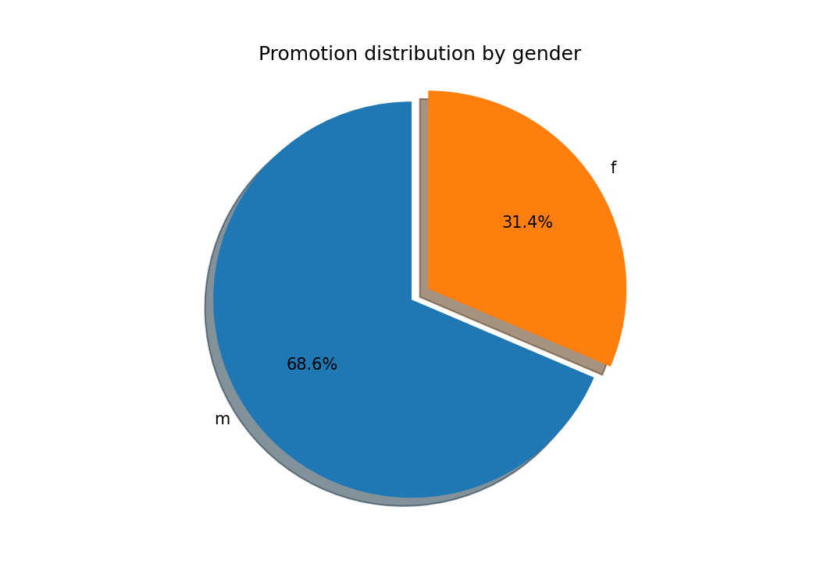
Who gets promoted earlier?
We weren’t able to find any significant difference in the amount of promotions depending on gender.
As we can see the distribution seems equal compared to the actual divide of gender
remember:

Slide 7
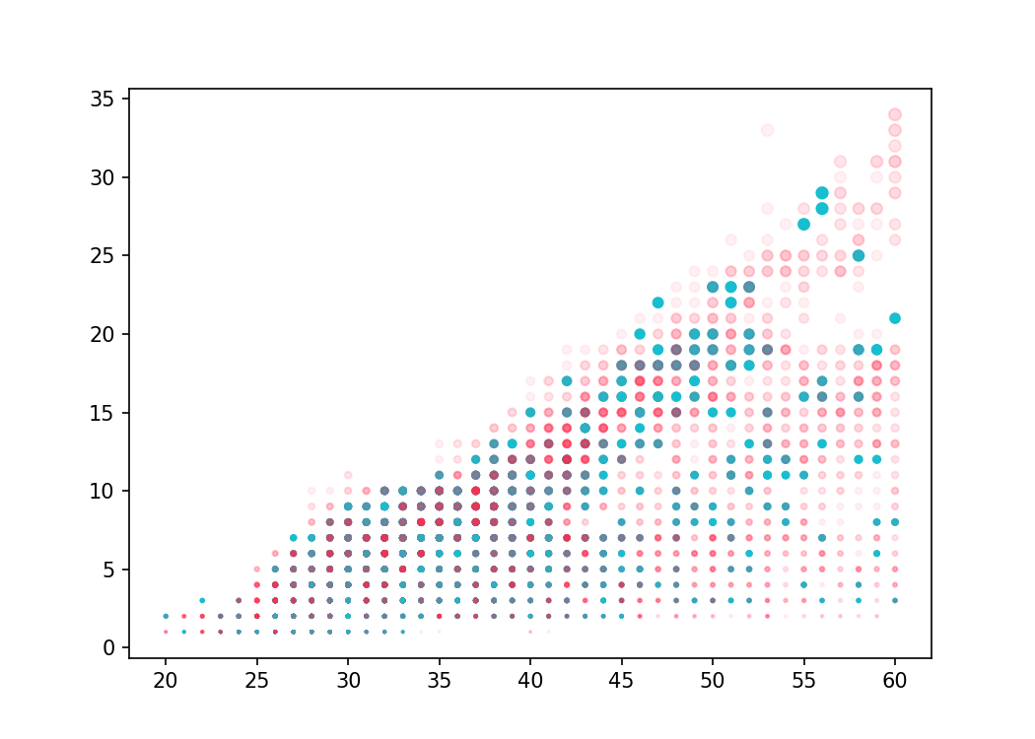
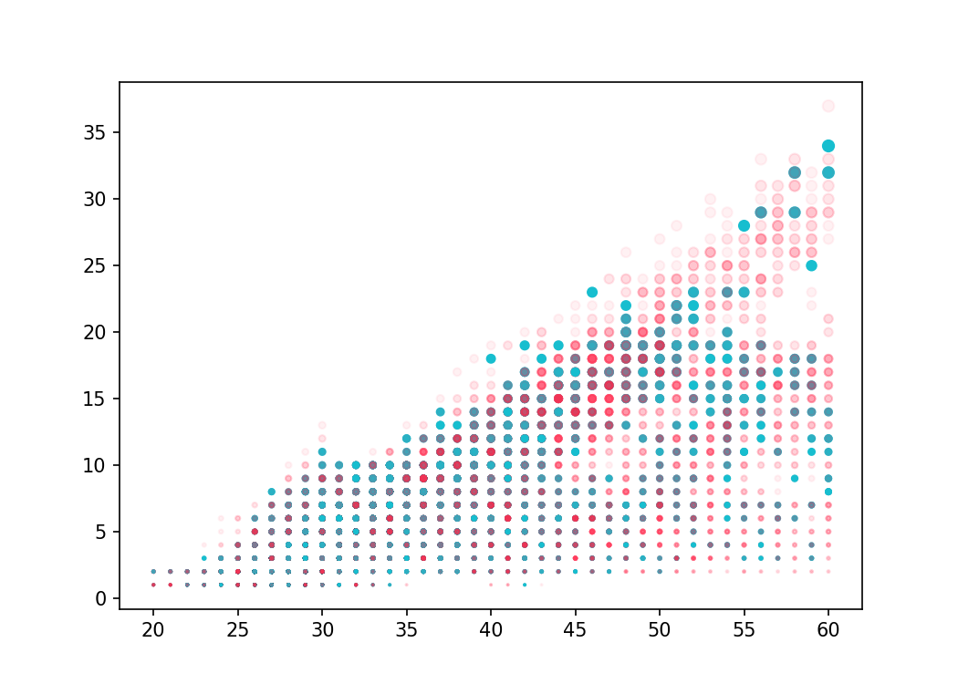
Who gets promoted earlier?
hasn’t been promoted
has been promoted
The lack in difference in promotions depending on gender can be seen more in depth here.
As have concluded that there aren’t any significant difference between these two groups, not even taking into account age bins
Age vs years in company: Female
Age vs years in company: Male
length of service
age

Slide 8
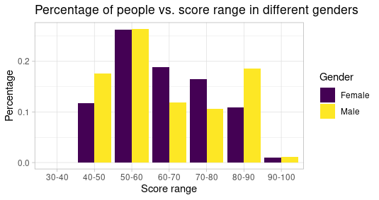
Gender Related to Average Training Score
There are 2 males who scored in the range (30,40), which is less than 0.1 percent of the total number of male.
From this observation we can see that males tend to have a higher variance in average training score. Given the average of both genders are relatively the same.

Slide 9
Promotions situations

Slide 10
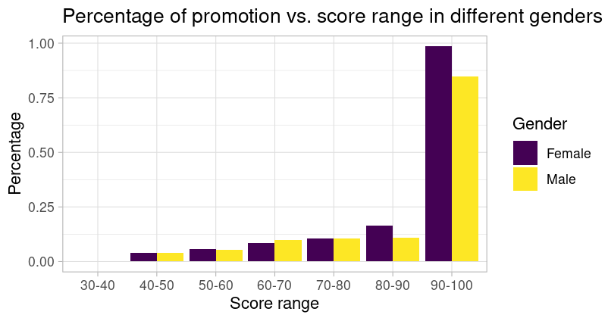
From this plot, it’s reasonable for us to accept the conclusion that in almost every score range, males and females have similar percentages of promotion, if females are not slight better.
This could be a good sign for gender equality improvement.

Slide 11
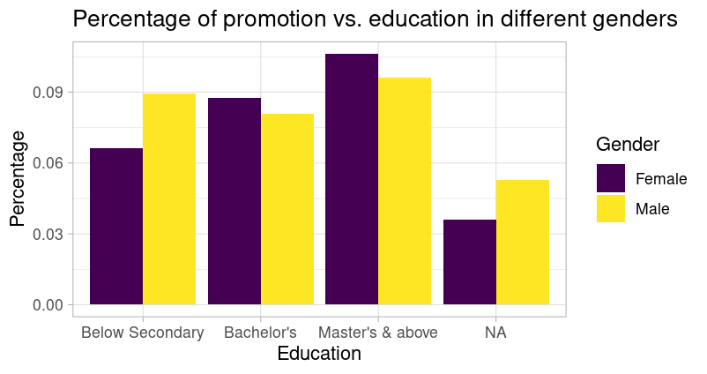
Similarly,. the trend observed in the previous plot can also be seen here. However, the “N/A” and “Below Secondary” parts are interesting. It may still indicate some potential inequality.

Slide 12
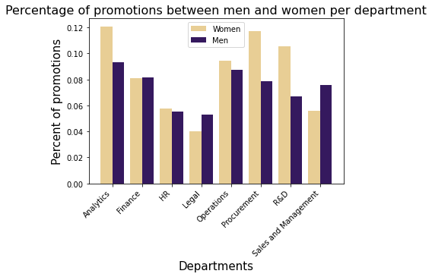
Promotions by Department
What can we see from this visualisation :
Percentage of women receiving a promotion out of total women per department is overall larger than their male counterparts
Disparity in Analytics, Procurement, R&D and Sales and Management
Men overtaking women largely only in legal and sales and management
Further analysis possible: Why?

Slide 13
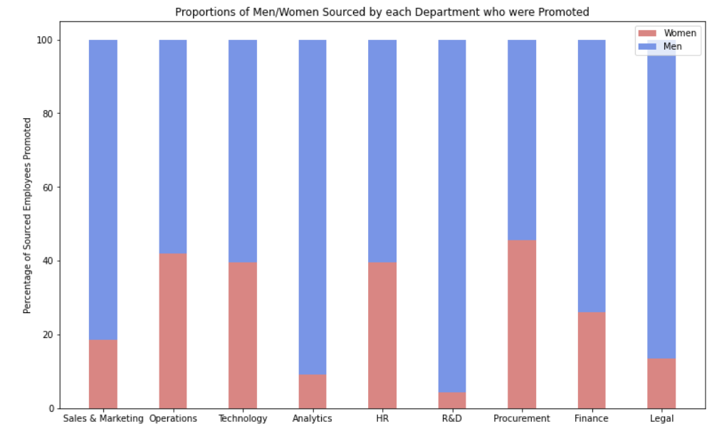
Proportions of Sourced Employees Promoted
As seen in the neighbouring chart:
The proportions of those sourced by each department getting a promotion reflects the gender imbalances of the departments’ populations.
Of those sourced by the R&D department, over 90% of those promoted were male. Although this matches the fact that ~90% of the department is male, it does show that sourcing employees has not been used to counterweight the male dominance in higher positions.

Slide 14
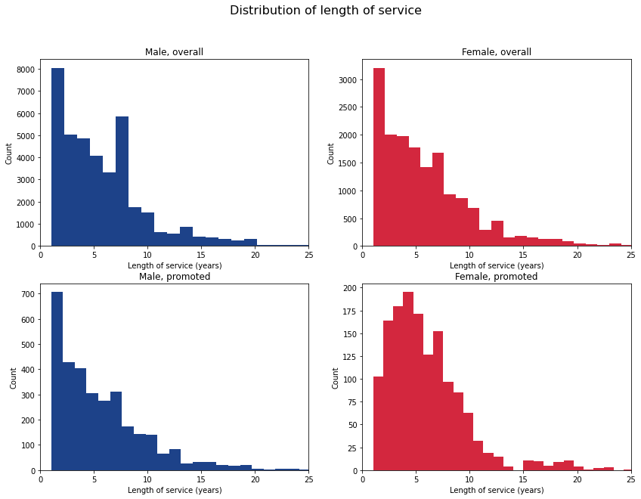
How long must women work for the company before they get promoted?
Most men who get promoted receive their promotion in their first year of working at the company.
There is a much smaller percentage of women being promoted in their first year. They tend to have to work at the company for 3-5 years before they receive a promotion.

Slide 15
Reflection
Upon looking at our data we made a very positive discovery that many of the women in this company had a seemingly equal chance of promotion to their male counterparts.
However, we were skeptical. This seemed very positive for this individual corporation however we were keen to investigate if the same level of standard of equality was being kept throughout other companies: specifically Silicon Valley

Slide 16
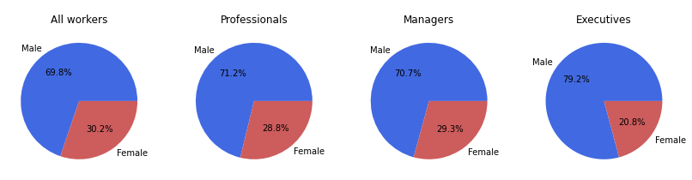
Gender distribution in the Silicon Valley job hierarchy
The more senior positions have an even lower percentage of female workers, showing that more promotions are being offered to male workers.

Slide 17
Conclusion
Although the prospect for promotion between the genders is fairly equal and seemingly only biased towards a womens length of service within the company (as seen in our first dataset and corresponding visualisation) we cannot unfortunately take this as a sweep statement for other companies.
When analysing the silicon valley data we seen a stark difference promotion possibilities

Slide 18


